Slide 1



Training of Neural Networks via Gradient Descent and Solvers
†
‡
☨
- Dhananjay Ashok†, Vineel Nagisetty‡, Christopher Srinivasa☨, Vijay Ganesh‡
Notes:
Yo Yo

Slide 2
Overview:
Presenting GDSolver: A novel hybrid approach to training DNNs that combines GD and MILP solvers to address the shortcomings of both approaches individually
GDSolver interprets the training of the final layer of a DNN as an MILP problem with the goal of tunnelling through and escaping the local Minima that GD gets stuck in.
For regression tasks, GDSolver produced models that, on average, had 31.5% lower MSE in 48% less time
For classification tasks on MNIST and CIFAR10, GDSolver was able to achieve the highest accuracy over all competing methods, using only 50% of the training data that GD baselines required

Slide 3
Problem: Training a Neural Network
Relevant Metrics/ Properties of the ideal training system
Leads to low loss/ high performance on chosen metric (MSE, BCE etc)
Generalizes well to testing set (avoids overfitting)
Fast/ Efficient
Scales well to large networks
But additionally
Produces networks of a certain type/ adhering to specified user constraints (e.g. adversarial robustness/ unbiasedness)

Slide 4
Approaches
Gradient Based Optimization:
Solver Based Optimization:
Notes:
Gradient Based Optimization:
View the neural network as a function and using gradient based optimization methods, iteratively minimize loss
Currently the algorithm of choice
Solver Based Optimization:
View the neural network as an MILP problem and use a solver to generate an assignment of weights which achieve training objectives
Only recently starting to be explored as training algorithms for NNs

Slide 5
Motivation: Solvers and Gradient Descent each have pros and cons
Local Minima
Constraints
Solvers
Gradient Descent
Overfits
Scalable
Provable

Slide 6
Motivation: Solvers and Gradient Descent each have pros and cons
Metric | Gradient Descent | Solver
Scalability | Scales well across high dimensional weight spaces and more data | Cannot efficiently find solutions over entire weight space/ large datasets
Quality of minima found | Tends to get stuck in local minima | Finds best solution/ optimal solution over the given range in an exhaustive manner
Nature of Objectives | Objectives to optimize must be differentiable | Handles more arbitrary constraints/ objectives
Provable Guarantees | Cannot give any provable guarantees of certain properties (robustness etc) | Is capable of proving properties over certain ranges of input
Generalization | Generalizes Better | Overfits Often

Slide 7
Proposed Algorithm Overview
Solver Fine Tuning
Hybrid Trained Model
Untrained Model
Gradient Descent
Step 1: Train with Gradient Descent Until Local Minimum
Step 2: Train the final layer of the DNN using an MILP Solver
Step 3: Alternate between Step 1 and Step 2
Step 4: Terminate when validation loss is satisfactory

Slide 8
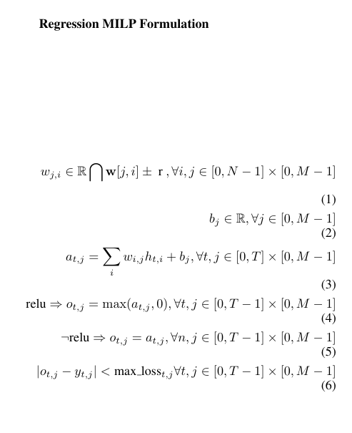
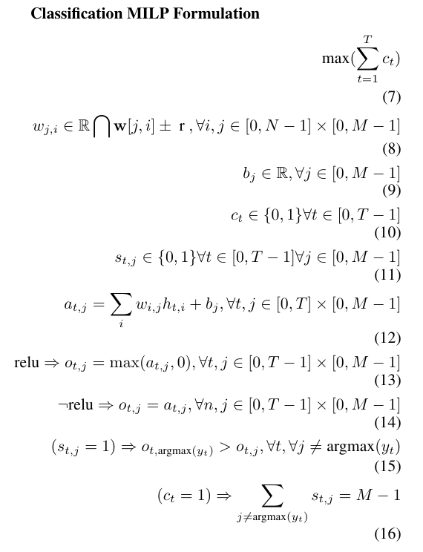
MILP Formulations
Inspired heavily by Training binarized neural networks using MIP and CP. (Icarte et al. 2019)

Slide 9
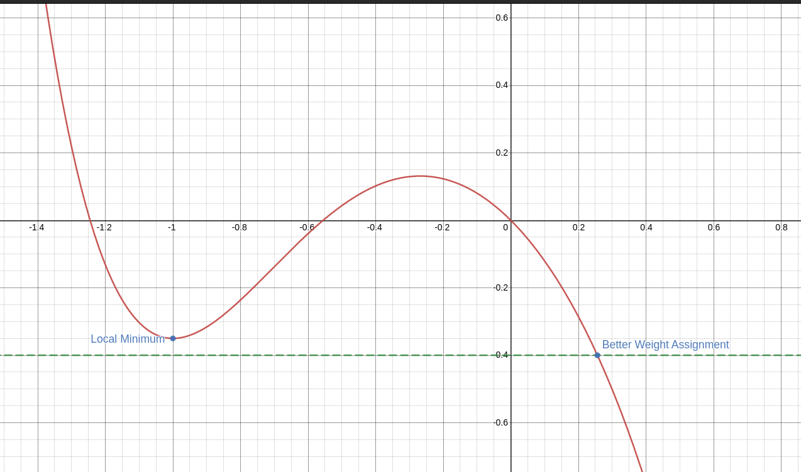
Use Cases of Solver-based Training:
Using a Solver sweep to tunnel through a local minimum

Slide 10
Experiments: Overview
We compare GDSolver against the four Gradient Descent baselines of
Stochastic GD,
SGD with Learning Rate Scheduling,
Adam Optimization and
Adam with LRS.

Slide 11
Experiment 1: Regression
Question: Can GDSolver achieve faster convergence with greater data and resource efficiency than GD baselines
Dataset: 4 simple regression datasets (identity, affine, polynomial of degree 4, and a trignometric and exponential formula) that pure GD methods can learn quickly
Procedure:
We vary the number of epochs e for each GD baseline, noting the testing loss and time taken.
We then compare this to the testing loss and time taken to complete e epochs of SGD and a single solver sweep of the final layer.
This also allows us to quantify how many additional epochs of GD would have been required to achieve equivalent loss

Slide 12
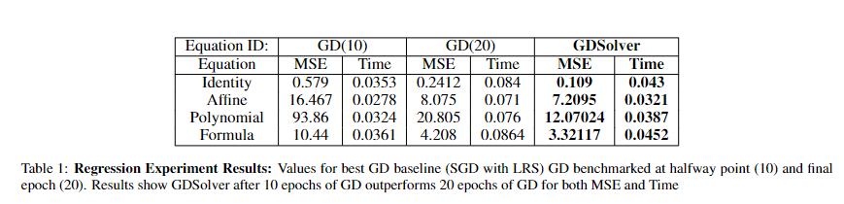
Experiment 1: Regression Results
For brevity the results shown are for the best GD baseline (SGD with LR Scheduling) at the median epoch and maximum epochs used - 10 and 20
For most datasets GDSolver performs better in 10 epochs than GD baseline does in 20 epochs
The time taken by GDSolver is at 10 epochs is significantly less than the time taken for 20 iterations of GD baseline, which is how long the baselines take to achieve a comparable loss.
GDSolver produced models with, on average, 31.5% lower MSE in 48% less time.

Slide 13
Experiment 2: Classification
Question: Does GDSolver consistently perform better than GD baseline in terms of generalization to a test set as the amount of training data is varied
Dataset: MNIST and CIFAR10
Procedure:
We vary the number of training datapoints n and epochs e used to train the baseline methods.
For comparison, using GDSolver we train for a maximum of e/2 epochs of SGD (n datapoints), stopping early and calling the solver if we detect a loss plateau; we do this process 2 times.
We measure the testing accuracy, and see whether GDSolver is able to reach a higher accuracy than GD baselines using a smaller e/n value.

Slide 14
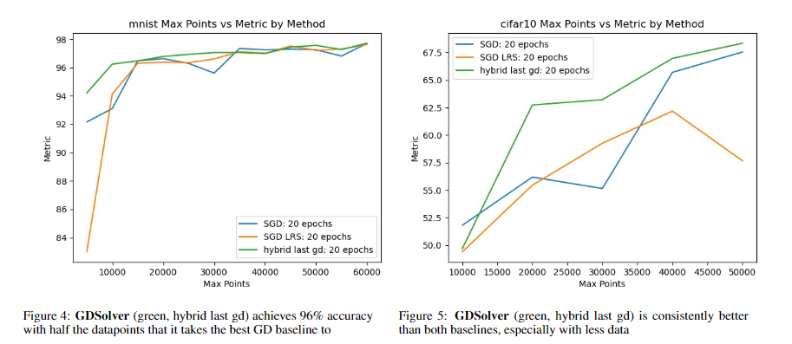
Experiment 2: Classification Results
On average the hybrid method outperforms all GD baselines in terms of testing accuracy
GDSolver performs much better when fewer data points are used, i.e more data efficient
GDSolver on MNIST and CIFAR10 achieves better accuracy than GD baselines with only 50% of the training data

Slide 15
Limitations
Depends highly on the final layer of the NN being able to make a significant difference to the loss performance
Varies significantly based on the training trajectory/ weights supplied by GD
Initial attempts at constraint satisfaction yield infeasible LP models and cannot give provable guarantees with current framework

Slide 16
Future Work
Transfer this method to other classes of solvers, such as SMT solvers, which are capable of handling highly non-linear constraints
Use Solvers to provide guarantees over adherence to security or reliability constraints.
Bias
Robustness to adversarial examples
Extend the GDSolver method to handle more various architectures in the final layer

Slide 17
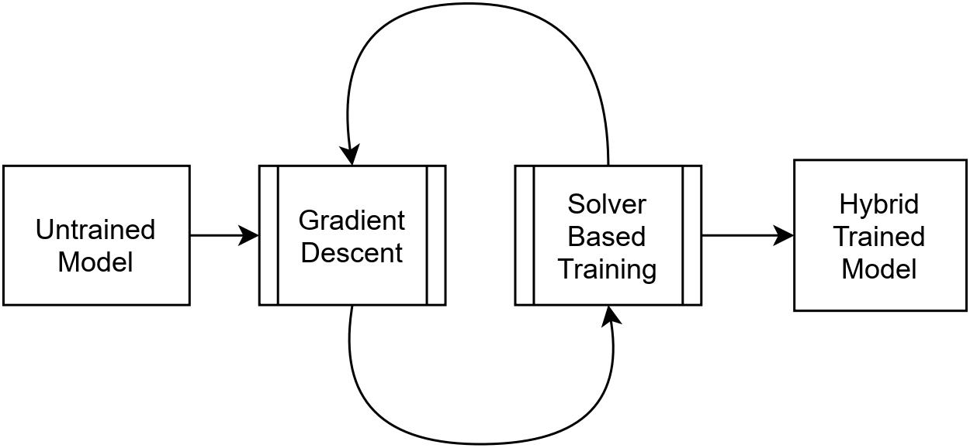
Conclusion
A combination of the GD and Solvers will be able to outperform the individual algorithms
We provide one possible way of combining the two methods and are able to show promising initial results on simple datasets
There is considerable room for expansion and future work using solvers and gradient descent to train NNs

Slide 18
Related Work:
Using Solvers for training of Neural Networks:
In search for a SAT-friendly binarized neural network architecture (Narodytska et al.2019)
Training binarized neural networks using MIP and CP. (Icarte et al. 2019)
On Training Neural Networks with Mixed Integer Programming (Thorbjarnarson et al.2020 )

Slide 19
Proposed Algorithm Overview
Step 1: Gradient Descent trains NN until local minimum/ loss plateau
Step 2: Convert the final layer alone of the network to an MILP problem (Fine Tuning)
Restrict the solver to find weight assignments that are close to the current weights
Step 3: Solve the fine tuning MILP problem and assign the weights to the NN
Step 4: Terminate or return to step 1

